Slide 1















EventEase
Advanced Database Management System
By : Kevin Anjalo & Navindu Ashen

Slide 2

Introduction & Project Context
EventEase is a custom database solution developed for I O N Groups Pvt Ltd to streamline event management, covering events, venues, tickets, attendees, payments, and feedback.
Purpose - Efficiently manage and analyze event-related data.
Goals
To design, implement, and develop a database system for an event management platform.
Tech Stack
Backend - Microsoft SQL Server
Frontend - Flask (web application)
Key Features
Structured ER model with normalization
SQL scripts for implementation
Triggers, views, functions, stored procedures
BI SQL Queries to Analyze Data

Slide 3
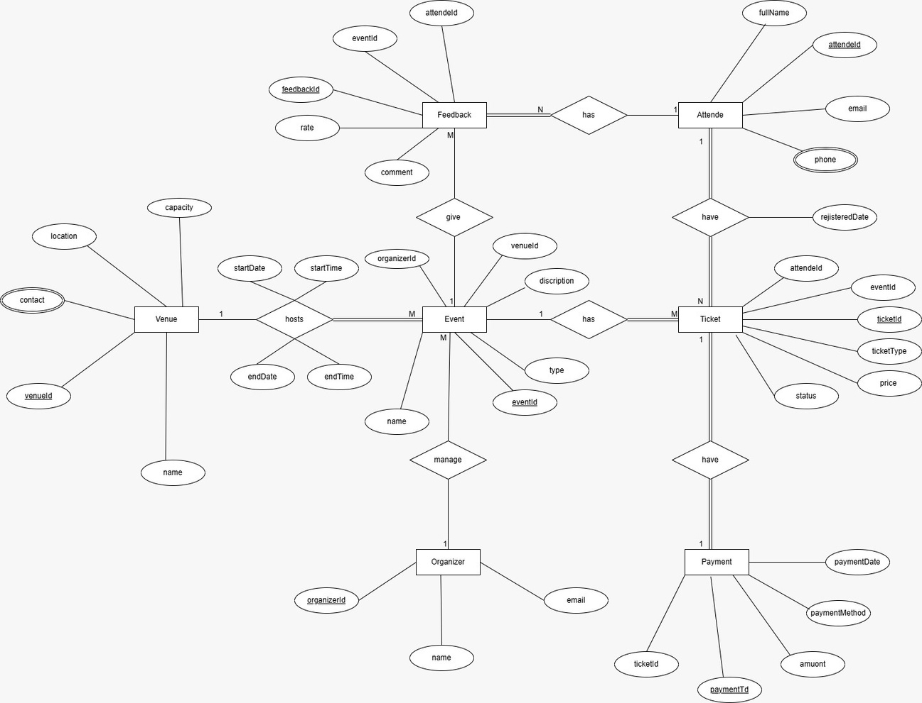
Database Design
ER Diagram
Visual blueprint of the database structure

Slide 4
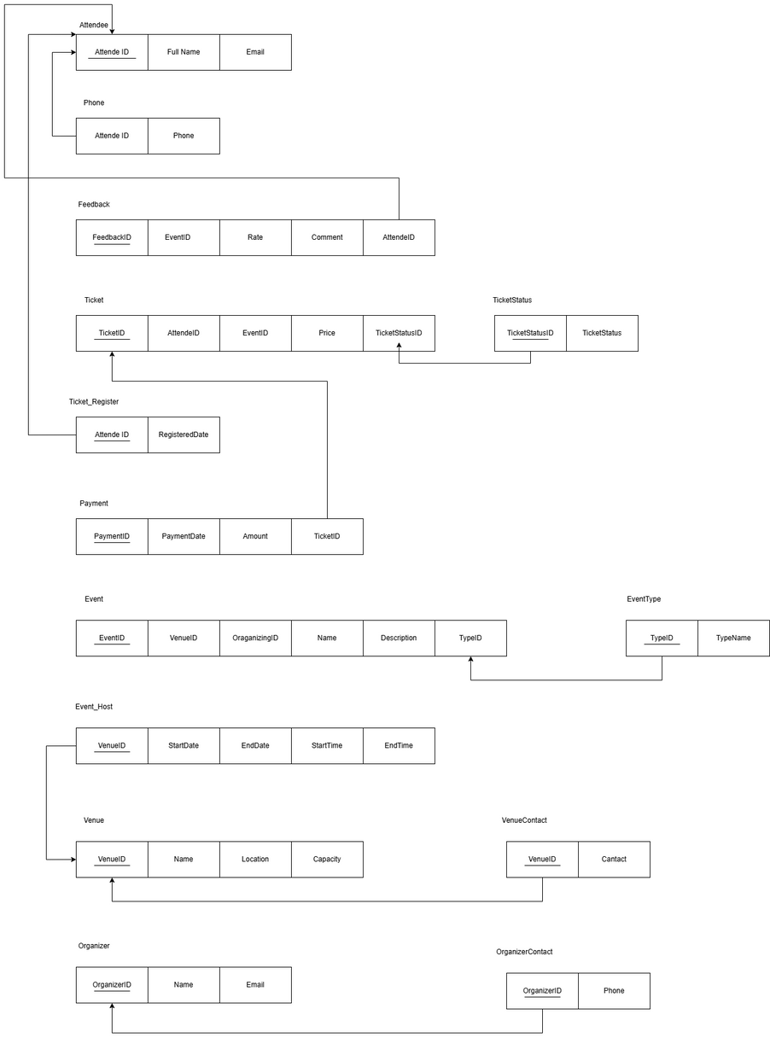
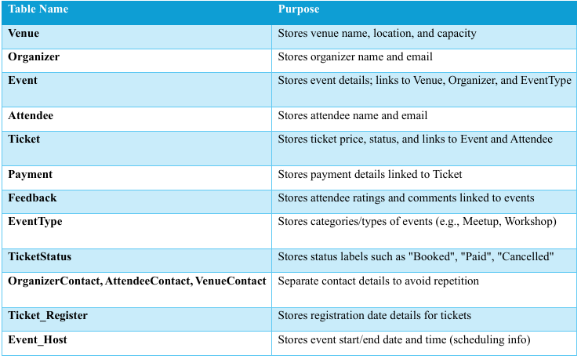

Database Design
Schema Structure

Slide 5
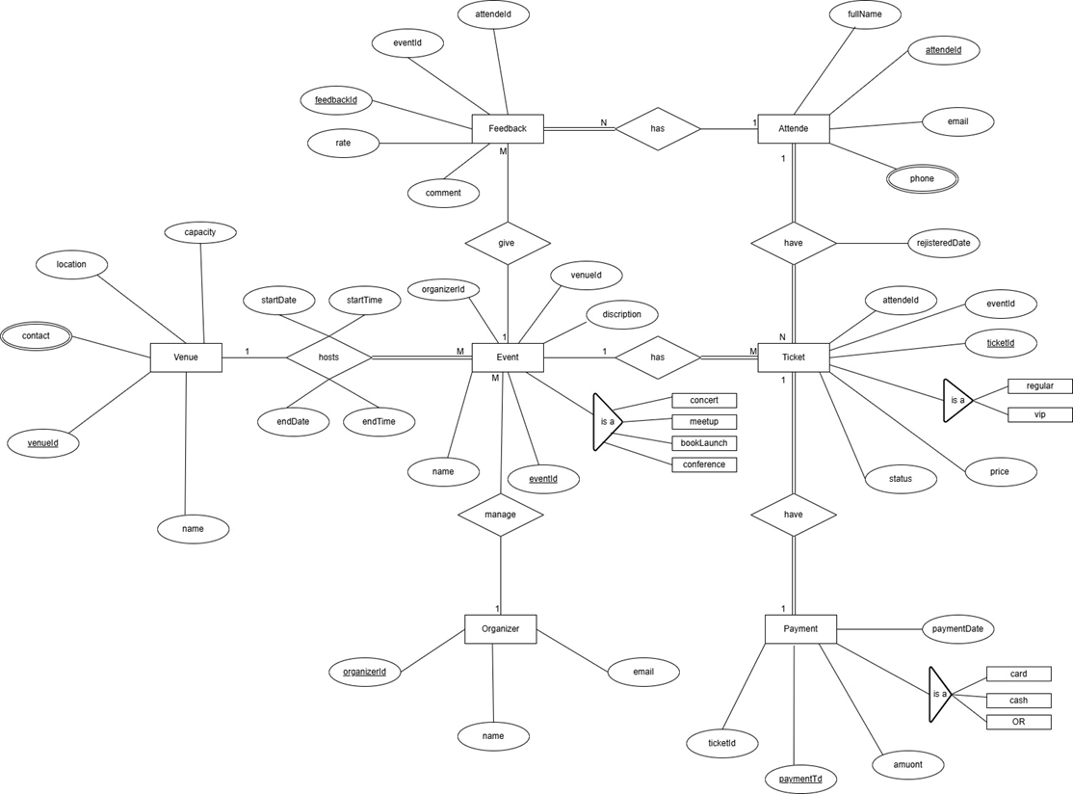
Enhanced ER Diagram

Slide 6
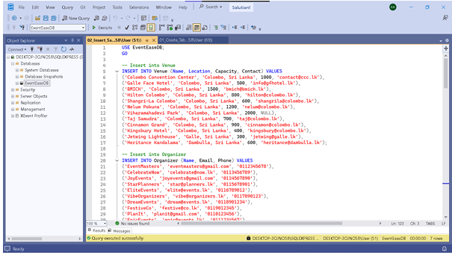
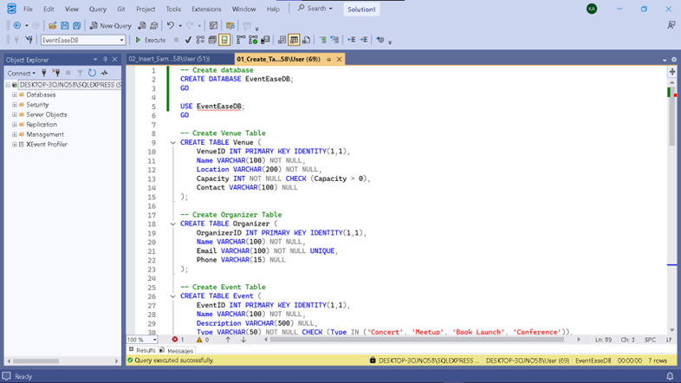
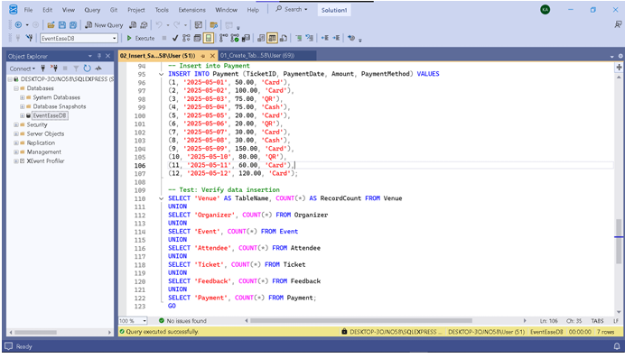
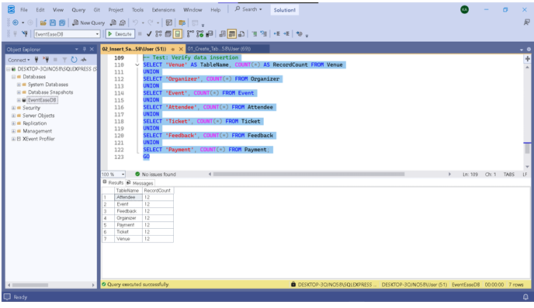
Database Implementation
DB Creation & Sample Data insertion
Queries for table creation and sample data insertion
Insert sample data into each table.
Create the EventEase database
and its core tables
Venue
Organizer
Event
Attendee
Ticket
Feedback
Payment

Slide 7
Triggers
Automate actions based on data modifications
(e.g., data integrity, auditing).
01.
Advanced Database Objects Overview
02.
User-Defined Functions (UDFs) Encapsulate reusable calculations for querying.
Leveraging SQL Server Features
Implemented objects to enhance database functionality and performance.
Views
Simplify complex queries and provide specific data perspectives for reporting/application use.
03.
Stored Procedures
Encapsulate complex business logic, execute as a single unit, improve performance and security.
04.

Slide 8

Triggers
ForAutomate actions based on data modifications (e.g., data integrity, auditing).
I. Update Venue Capacity Trigger
II. Audit Feedback Trigger
III. Prevent Event Deletion Trigger

Slide 9
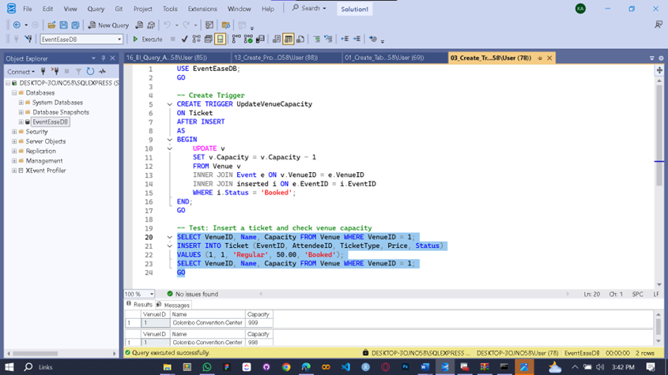
Trigger For Update Venue Capacity
Purpose - Automatically reduce available venue capacity when a ticket is booked.
Trigger Name - UpdateVenueCapacity
Fires on - Ticket table, AFTER INSERT.
Logic - If a new ticket is inserted with Status = 'Booked', it decrements the Capacity in the associated Venue record by 1.
Benefit - Real-time capacity tracking, prevents overbooking.

Slide 10
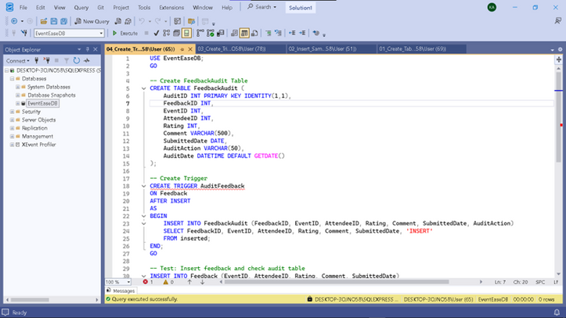
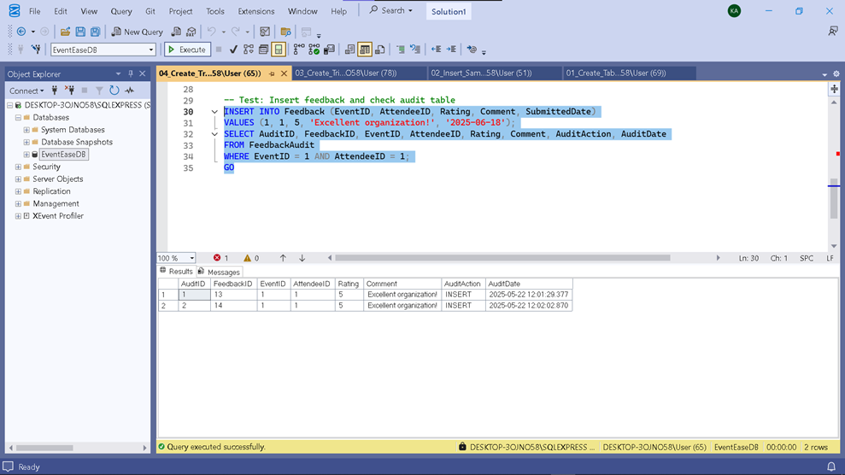
Trigger For Feedback Audit Trail
Purpose - Log every new feedback submission for auditing purposes.
Trigger Name - Audit Feedback
Fires on - Feedback table, AFTER INSERT.
Logic - Inserts the details of the newly inserted feedback row into a Feedback Audit table with an action ('INSERT') and timestamp.
Benefit - Provides a historical record of feedback entries.

Slide 11
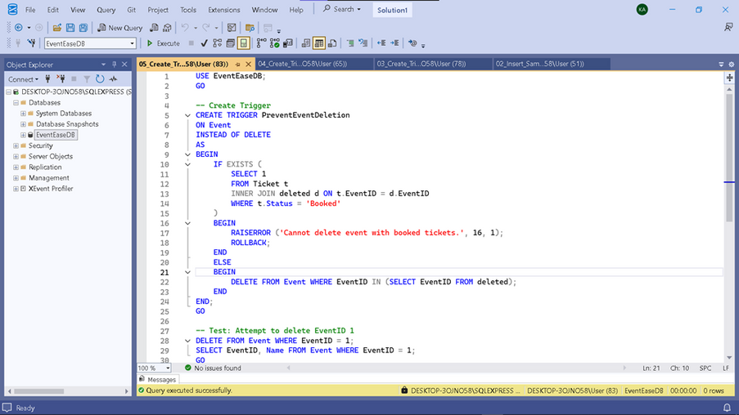
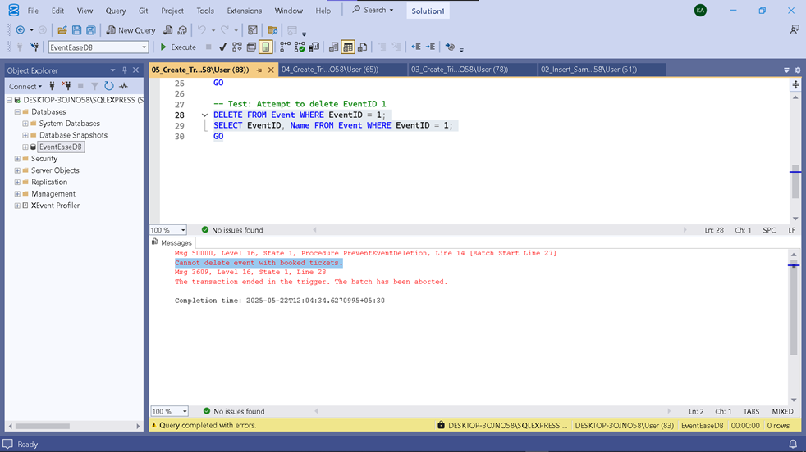
Trigger For Prevent Event Deletion
Purpose - Prevent accidental deletion of events that still have booked tickets.
Trigger Name - PreventEventDeletion
Fires on - Event table, INSTEAD OF DELETE.
Logic - Before deleting an event, checks the Ticket table for any associated tickets with Status = 'Booked'. If found, it raises a custom error (RAISERROR) and rolls back the transaction. Otherwise, the deletion proceeds.
Benefit - Maintains data integrity by preventing orphaned ticket records and protecting active events.

Slide 12
User-Defined Functions (UDFs)
Reusable code blocks that return a single scalar value or a table. Used here for common calculations.
GetTotalRevenue(@EventID) - Returns total revenue from booked tickets for an event.
GetAttendeeCount(@EventID) - Returns the number of booked tickets (attendees) for an event.
GetAverageRating(@EventID) - Returns the average feedback rating for an event.
Benefit - Encapsulates calculation logic, simplifies queries using these values.

Slide 13
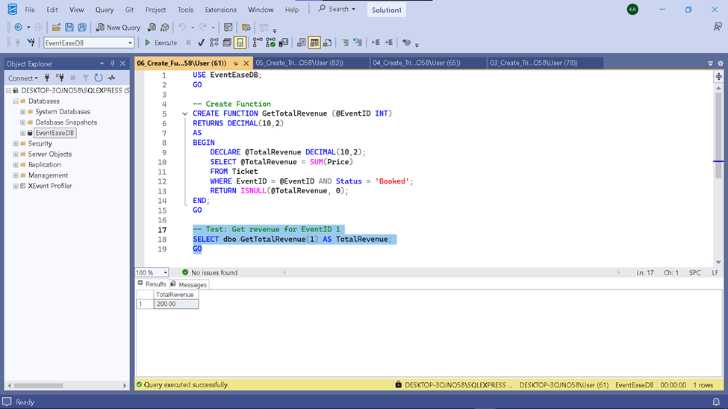
Function For Get Total Revenue
The GetTotalRevenue function accepts an @EventID as input and returns the total revenue generated from Booked tickets for that event.
It sums the Price of tickets where the EventID matches and the Status is 'Booked'. It returns 0 if no booked tickets are found.

Slide 14
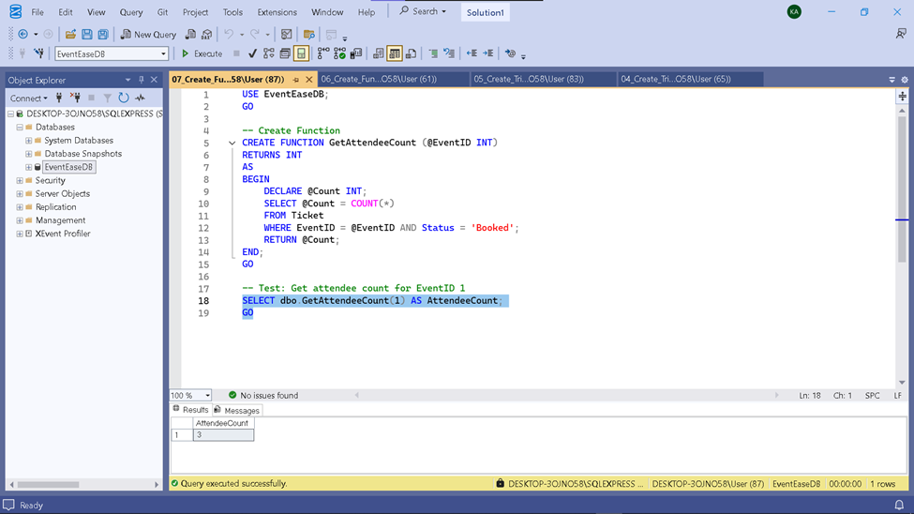
Function For Get Attendee Count
The GetAttendeeCount function accepts an @EventID as input and returns the number of Booked tickets for that event.
It counts the number of tickets where the EventID matches and the Status is 'Booked'.

Slide 15
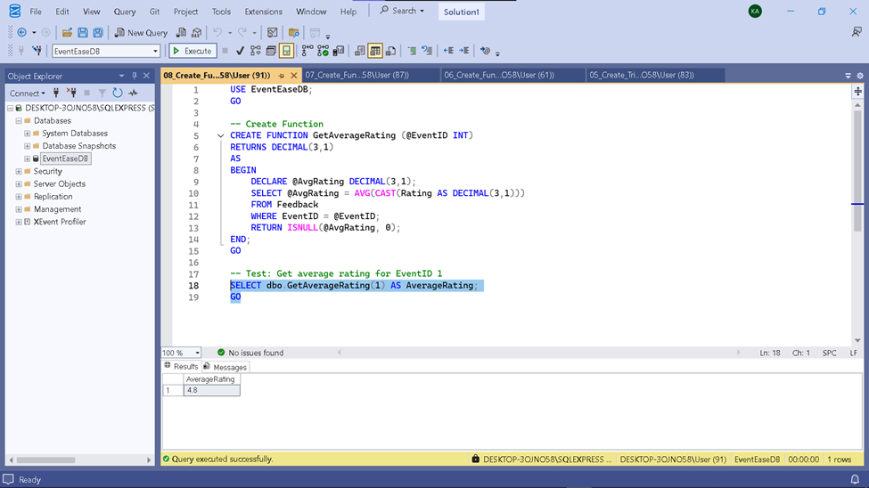
Function For Get Average Rating
The GetAverageRating function accepts an @EventID as input and returns the average Rating from feedback received for that event.
It calculates the average of the Rating column in the Feedback table for the specified EventID. It handles cases where no feedback exists by returning 0.

Slide 16

Views
Virtual tables based on the results of a query. Simplify complex joins and present data in a user-friendly way.
EventDetails - Combines Event, Venue, and Organizer details.
AttendeeTickets - Combines Ticket, Event, and Attendee details.
EventFeedbackSummary - Summarizes feedback count and average rating per event.
Benefit - Simplifies data retrieval for reports and the web application.

Slide 17
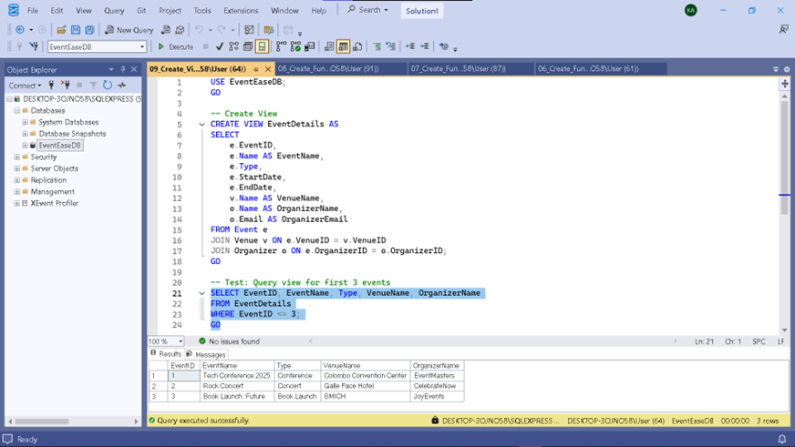
Event Details View
The EventDetails view joins the Event, Venue, and Organizer tables.
It provides a consolidated view of event information, including the event name, type, start/end dates, and the names and email addresses of the venue and organizer.

Slide 18
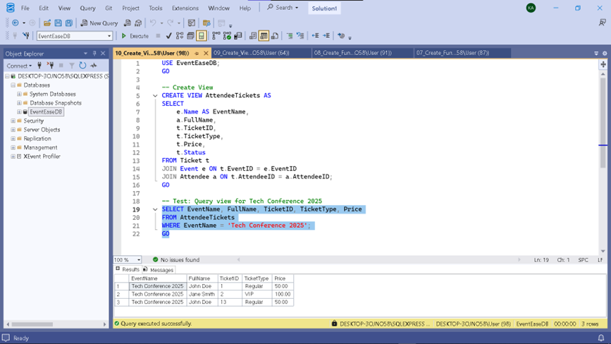
Attendee Tickets View
The AttendeeTickets view joins theTicket, Event, and Attendee tables.
It provides a view showing which attendees have booked which tickets for which events, including the ticket details (ID, Type, Price, Status) and attendee name.

Slide 19
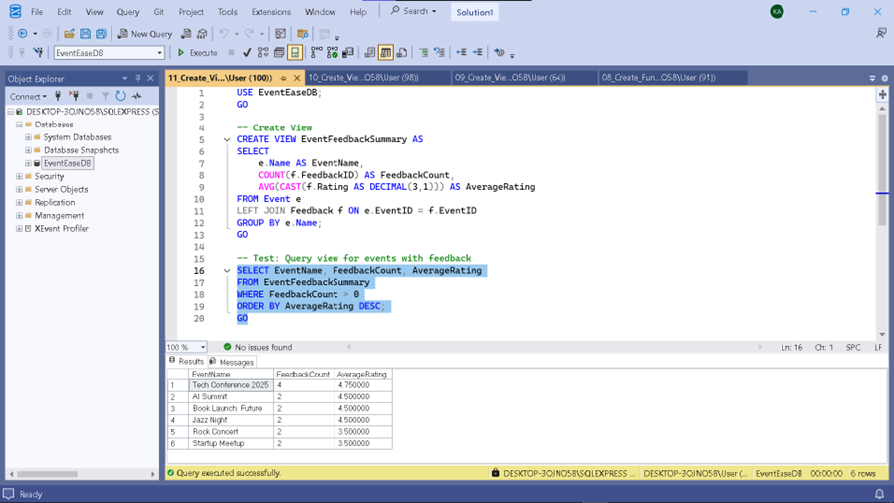
Event Feedback Summary View
The EventFeedbackSummary view joins the Event and Feedback tables.
It summarizes feedback per event, showing the event name, the count of feedback entries received (FeedbackCount), and the average rating (AverageRating). It uses a LEFT JOIN to include events that may not have received feedback yet.

Slide 20
Stored Procedures
Pre-compiled SQL code that performs a specific task. Encapsulates complex logic and improves performance/security.
InsertEvent - Handles the logic for adding a new event, including validation checks (VenueID, OrganizerID, Date ranges).
TicketSalesReport - Generates a summary of ticket sales (count and revenue) for booked events.
Benefit - Centralizes business logic, ensures data integrity for inserts, provides structured reporting.

Slide 21
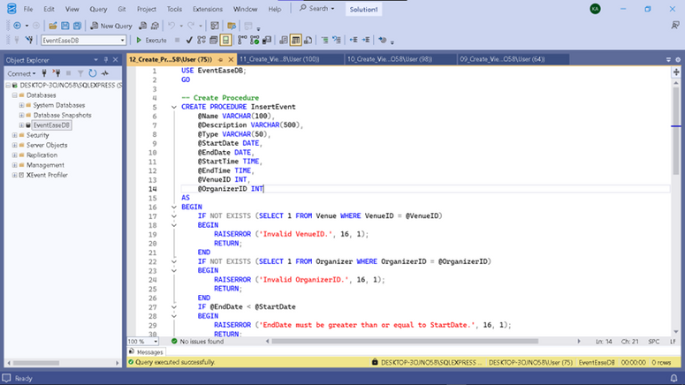
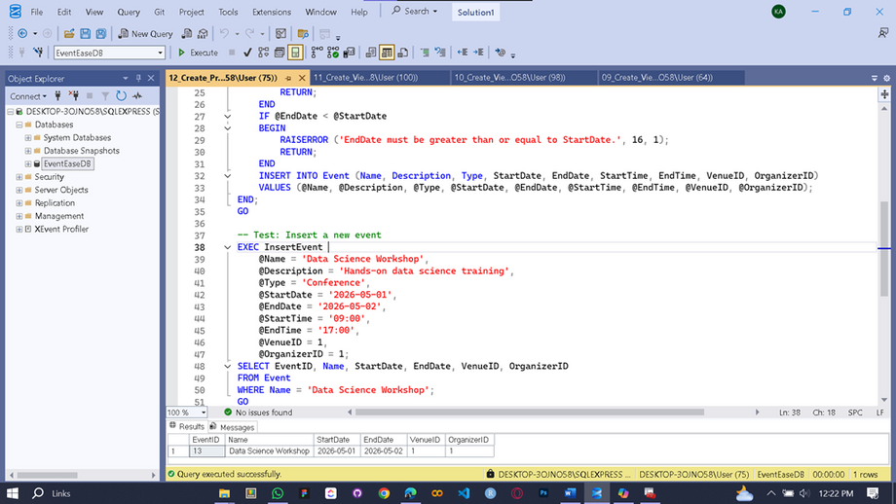
Procedure for Inserting Events
The InsertEvent procedure handles the insertion of new events.
It takes all event details as parameters. Before inserting, it validates the provided VenueID and OrganizerID by checking if they exist in their respective tables.
It also checks if the EndDate is not before the StartDate.
If any validation fails, it raises an error and returns, preventing the insert. Otherwise, it inserts the new event record.

Slide 22
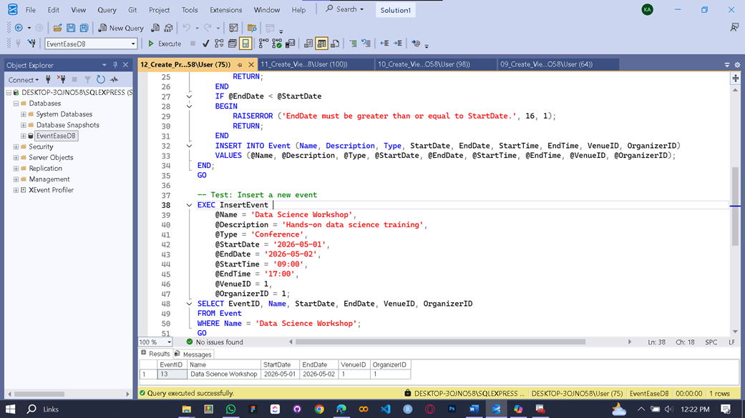
Procedure for Ticket Sales Report
The TicketSalesReport procedure generates a summary report of ticket sales for Booked tickets.
It joins the Event and Ticket tables, groups by event name, and calculates the total TicketsSold (count of booked tickets) and TotalRevenue (sum of prices of booked tickets).
The results are ordered by total revenue descending.

Slide 23
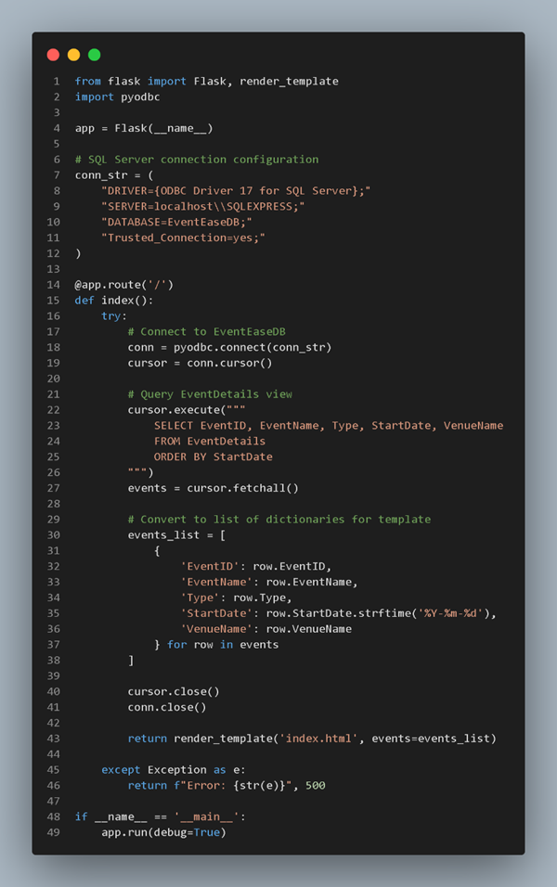
Web Application
Overview
A sample Flask application to demonstrate database interaction.
Provides a basic user interface for browsing events.
Connects to the SQL Server EventEaseDB.
Technology - Python (Flask).

Slide 24
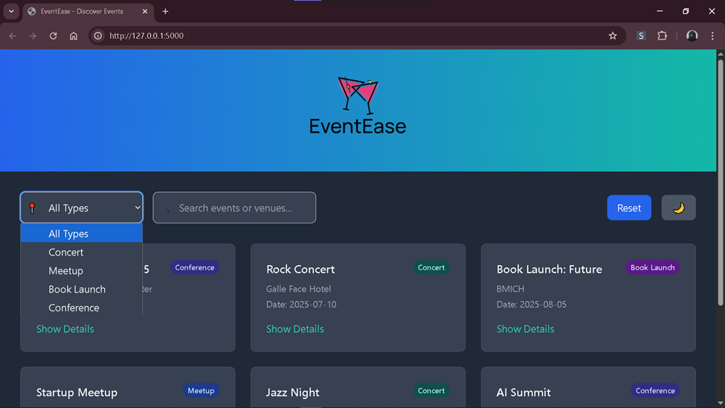
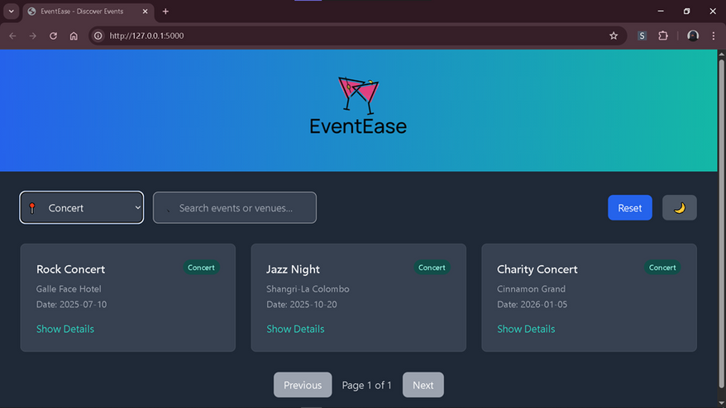

Web Application Functionality
Implemented Features
Event Listing - Displays available events from the database.
Event Filtering - Allows filtering events based on type
(e.g., Concert, Conference).
Demonstration - Shows how the application fetches and presents data from the database to the user.

Slide 25
Business Intelligence
(BI) Analysis
Purpose - Utilize the database to gain insights into event performance and attendee behavior.
Approach - Specific SQL queries designed to provide valuable BI metrics.
Focus Areas - Event popularity, sales performance, attendee satisfaction.
Key BI Queries Implemented
Event Popularity Report
Ticket Sales Summary
Attendee Satisfaction Analysis
Provides actionable insights for optimizing events and understanding attendee preferences.

Slide 26
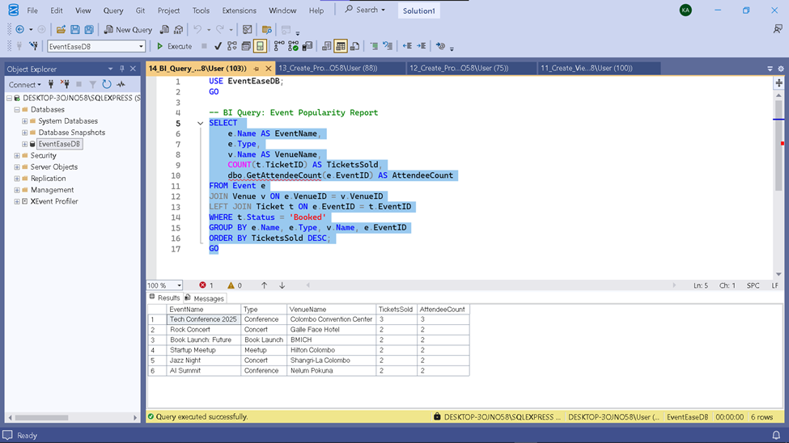
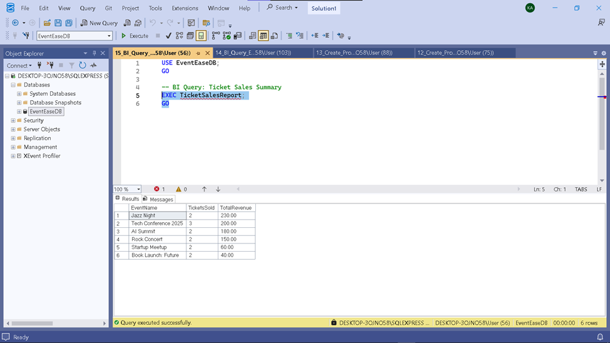
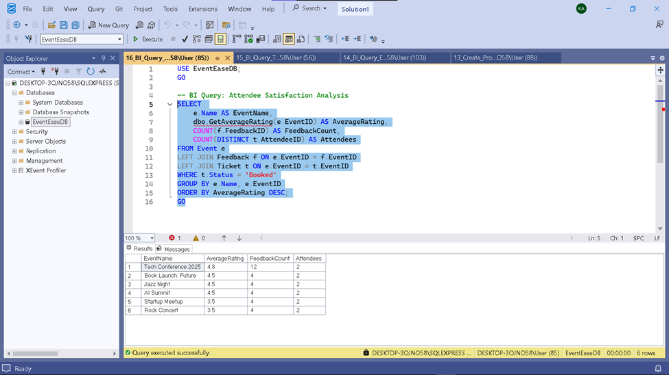
BI Analysis
01
02
03
Event Popularity Report
Event Popularity Report
Event Popularity Report
This query analyzes event popularity by combining event, venue, and ticket data.
It displays the event name, type, venue, tickets sold, and unique attendee count (via GetAttendeeCount), sorted by ticket sales in descending order.
TicketSalesReport stored procedure to display each event’s ticket sales and total revenue.
Only events with booked tickets are included, sorted by revenue in descending order.
This query evaluates attendee satisfaction by joining event, feedback, and ticket data.
It shows each event's name, average rating (GetAverageRating), number of feedback entries, and unique attendee count (GetAttendeeCount), ordered by average rating in descending order.

Slide 27

Conclusion
Successfully designed and implemented the EventEase database in SQL Server.
Ensured data integrity and a structured foundation through ER modeling and normalization.
Leveraged advanced SQL features (Triggers, Functions, Views, Procedures) for robust functionality.
Demonstrated database usability via a sample Flask web application.
Supported business intelligence requirements with key analytical queries.
Project provides a solid backend for an efficient event management platform.

Slide 28
Thank you

